Slide 1
Lec 7: Systems and Classification of Systems
Dr. Arsla Khan

Slide 2
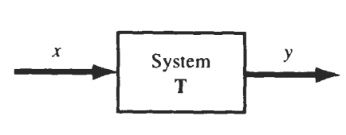
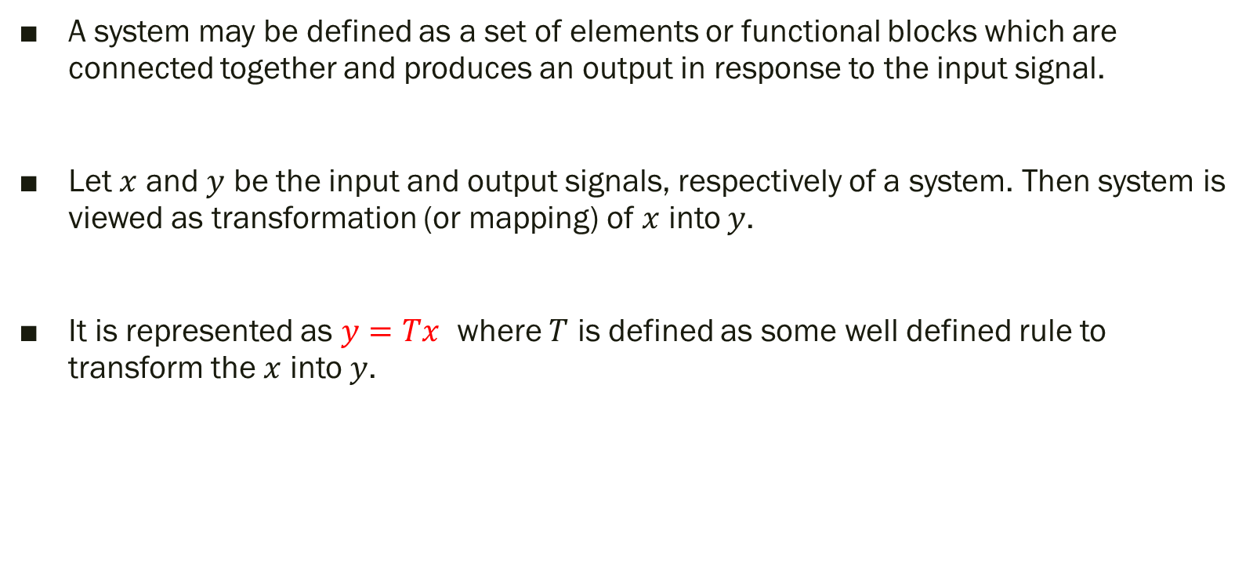
System
A system may be defined as a set of elements or functional blocks which are connected together and produces an output in response to the input signal.
Let $x$ and $y$ be the input and output signals, respectively of a system. Then system is viewed as transformation (or mapping) of $x$ into $y$.
It is represented as $y=Tx$ where $T$ is defined as some well defined rule to transform the $x$ into $y$.

Slide 3
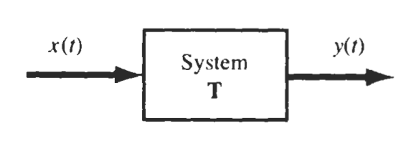
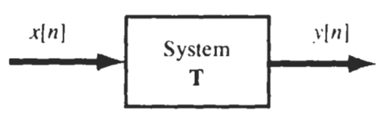
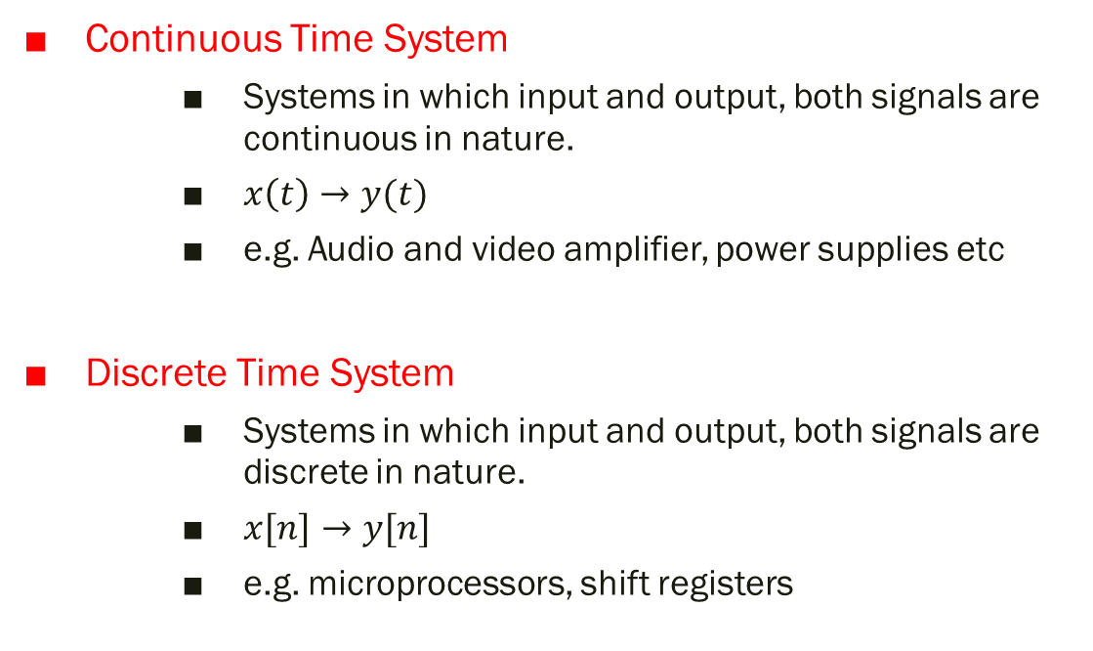
Types of Systems
Continuous Time System
Systems in which input and output, both signals are continuous in nature.
$x\left(t\right)→y(t)$
e.g. Audio and video amplifier, power supplies etc
Discrete Time System
Systems in which input and output, both signals are discrete in nature.
$x[n]→y[n]$
e.g. microprocessors, shift registers

Slide 4
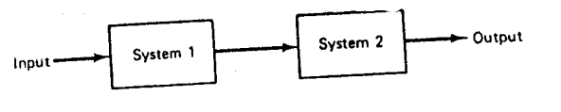
Interconnection of Systems
Systems can be interconnected in multiple ways
1) Series(Cascaded) Interconnection
Output of system 1 is input of other system
Overall impulse response is equal to convolution of individual impulse responses.

Slide 5
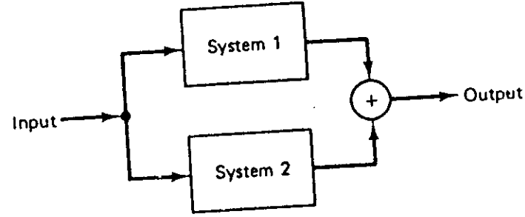
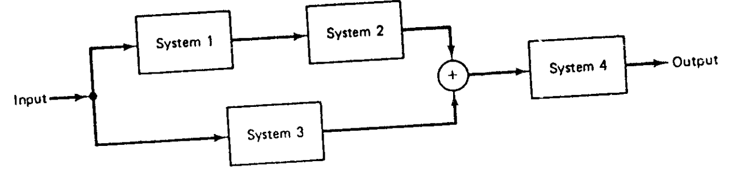
2) Parallel Interconnection
Same input is applied to all systems.
Overall impulse response is equal to addition of individual impulse responses
3) Series/Parallel Interconnection
Combination of series and parallel combination

Slide 6
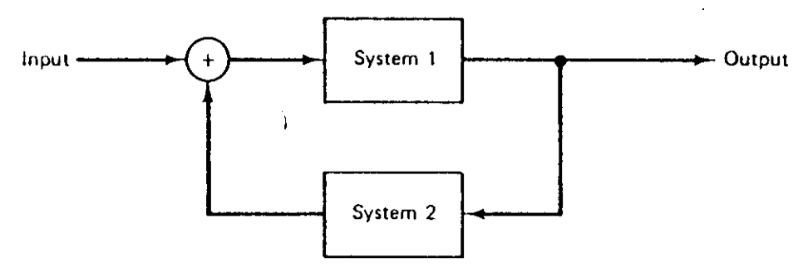
4) Feedback Interconnection
Output of system 1 is the input to system 2, while the output of system 2 is fed back and added to the external input to produce the actual input to system 1.

Slide 7
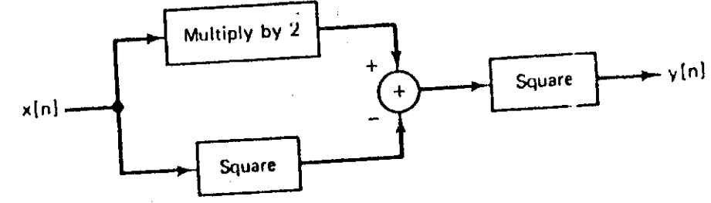

Exp 7.1: Write relationship between input and output signals
Multiple input $x[n]$ by 2 → $2x\left[n\right]$
Square of input $x[n]$ → ${x[n]}^{2}$
Relationship is: $y\left[n\right]= {(2x\left[n\right]−{x[n]}^{2})}^{2}$

Slide 8
Classification of Systems
i) Causal Systems and Non-causal Systems
ii) Static Systems and Dynamic Systems
iii) Time-invariant Systems and Time-variant Systems
iv) Stable Systems and Unstable Systems
v) Linear Systems and Non-linear Systems
vi) Invertible Systems and Inverse Systems

Slide 9
1) Causal and Non-Causal Systems
A system is said to be causal if the response or output does not begin before the input function is applied.
In other words,
Response of the causal system to an input does not depend on future values of that input but depends only on the present and past values of the input.

Slide 10
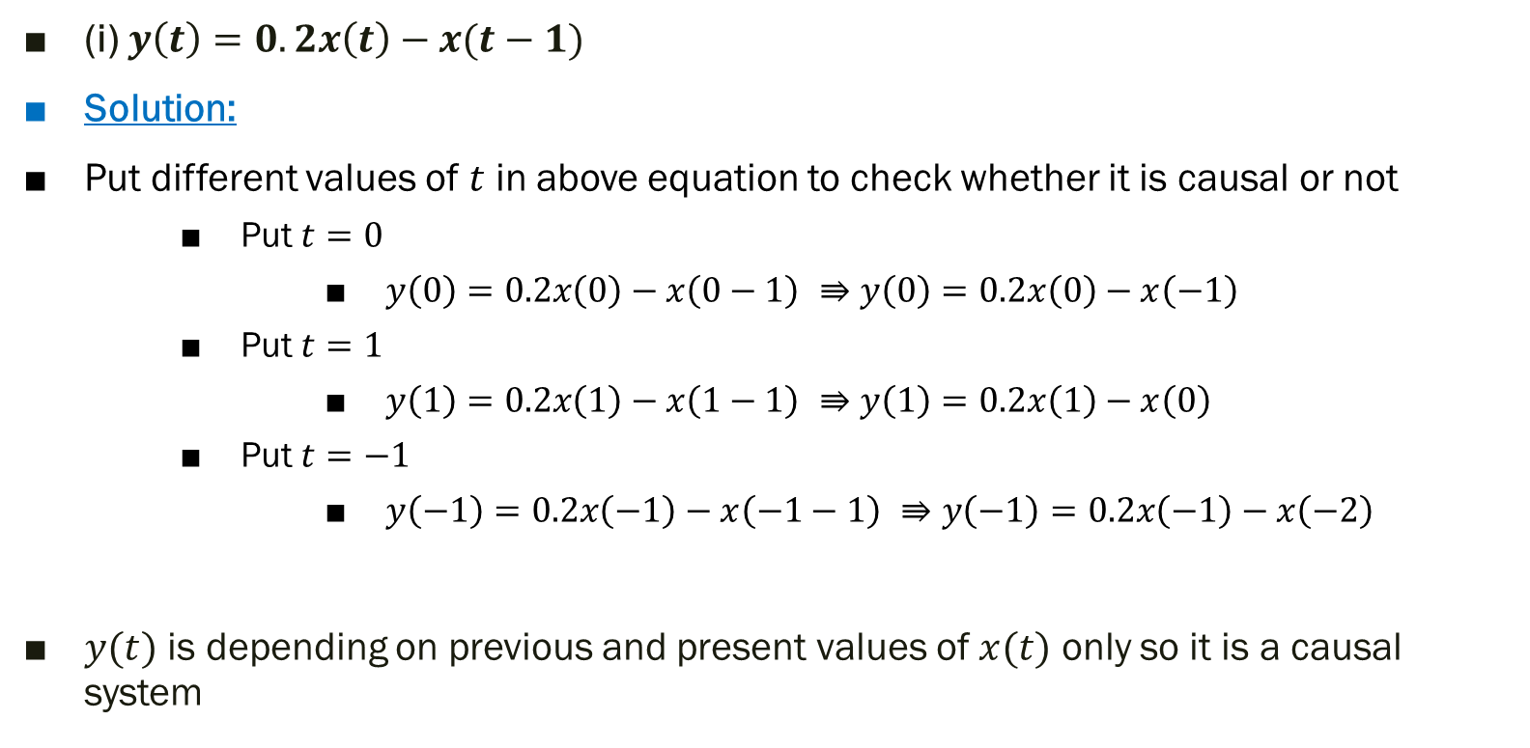
Exp 7.2: Determine whether the systems are causal or non-causal
(i) $y\left(t\right)=0.2x\left(t\right)−x(t−1)$
Solution:
Put different values of $t$ in above equation to check whether it is causal or not
Put $t=0$
$y\left(0\right)=0.2x\left(0\right)−x\left(0−1\right) ⇛y\left(0\right)=0.2x\left(0\right)−x\left(−1\right)$
Put $t=1$
$y\left(1\right)=0.2x\left(1\right)−x\left(1−1\right) ⇛y\left(1\right)=0.2x\left(1\right)−x\left(0\right)$
Put $t=−1$
$y\left(−1\right)=0.2x\left(−1\right)−x\left(−1−1\right) ⇛y\left(−1\right)=0.2x\left(−1\right)−x\left(−2\right)$
$y(t)$ is depending on previous and present values of $x(t)$ only so it is a causal system
Present value of input
Past value of input

Slide 11
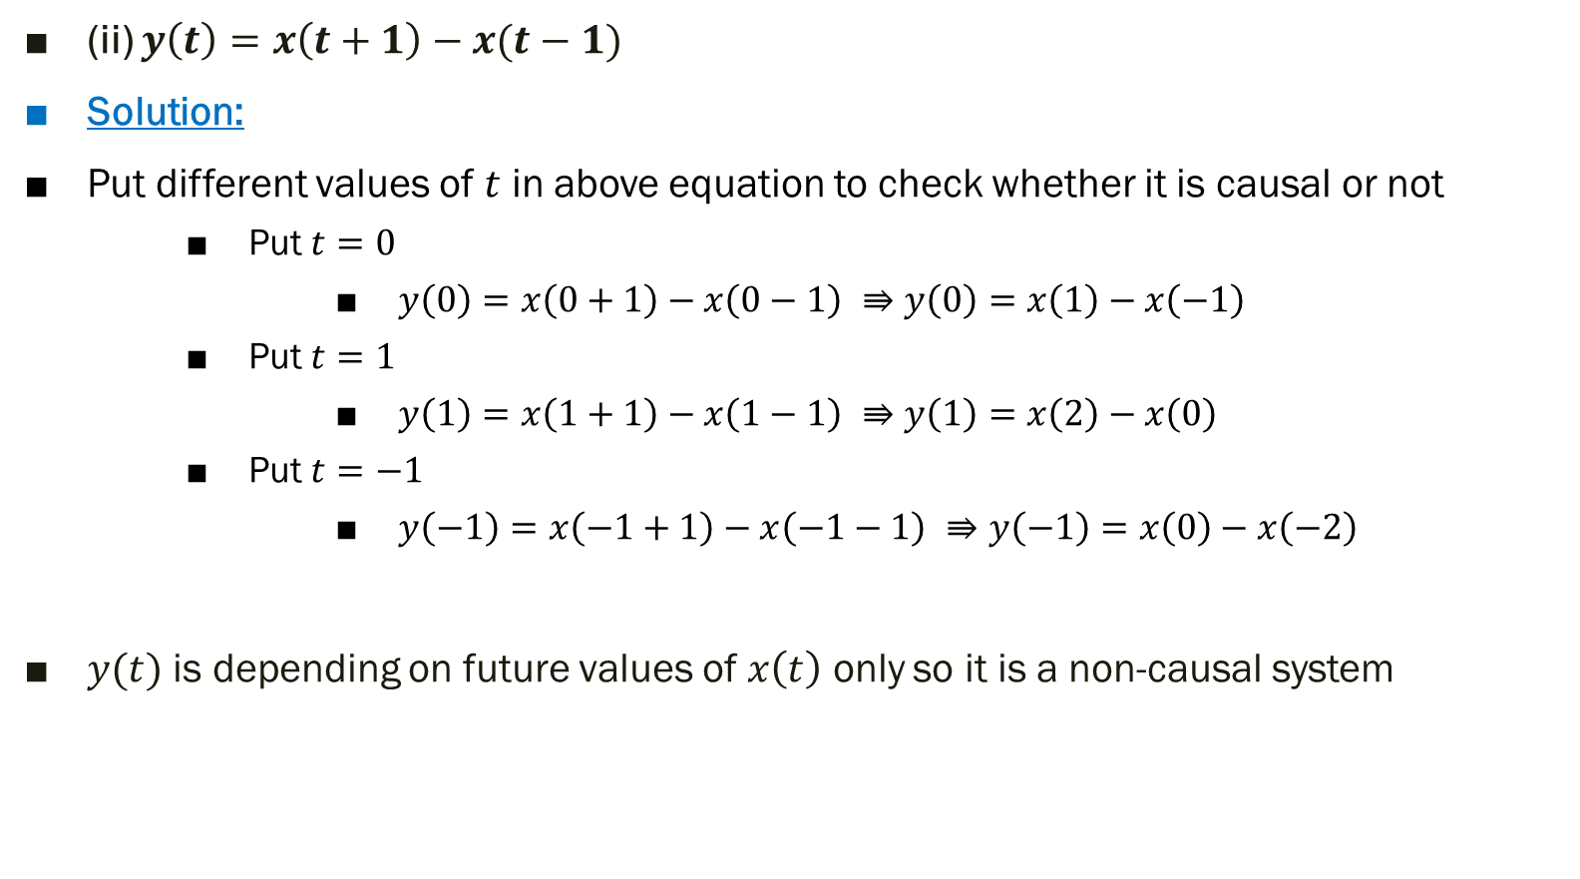
(ii) $y\left(t\right)=x\left(t+1\right)−x(t−1)$
Solution:
Put different values of $t$ in above equation to check whether it is causal or not
Put $t=0$
$y\left(0\right)=x\left(0+1\right)−x\left(0−1\right) ⇛y\left(0\right)=x\left(1\right)−x\left(−1\right)$
Put $t=1$
$y\left(1\right)=x\left(1+1\right)−x\left(1−1\right) ⇛y\left(1\right)=x\left(2\right)−x\left(0\right)$
Put $t=−1$
$y\left(−1\right)=x\left(−1+1\right)−x\left(−1−1\right) ⇛y\left(−1\right)=x\left(0\right)−x\left(−2\right)$
$y(t)$ is depending on future values of $x\left(t\right)$ only so it is a non-causal system
Future value of input
Future value of input
Future value of input

Slide 12
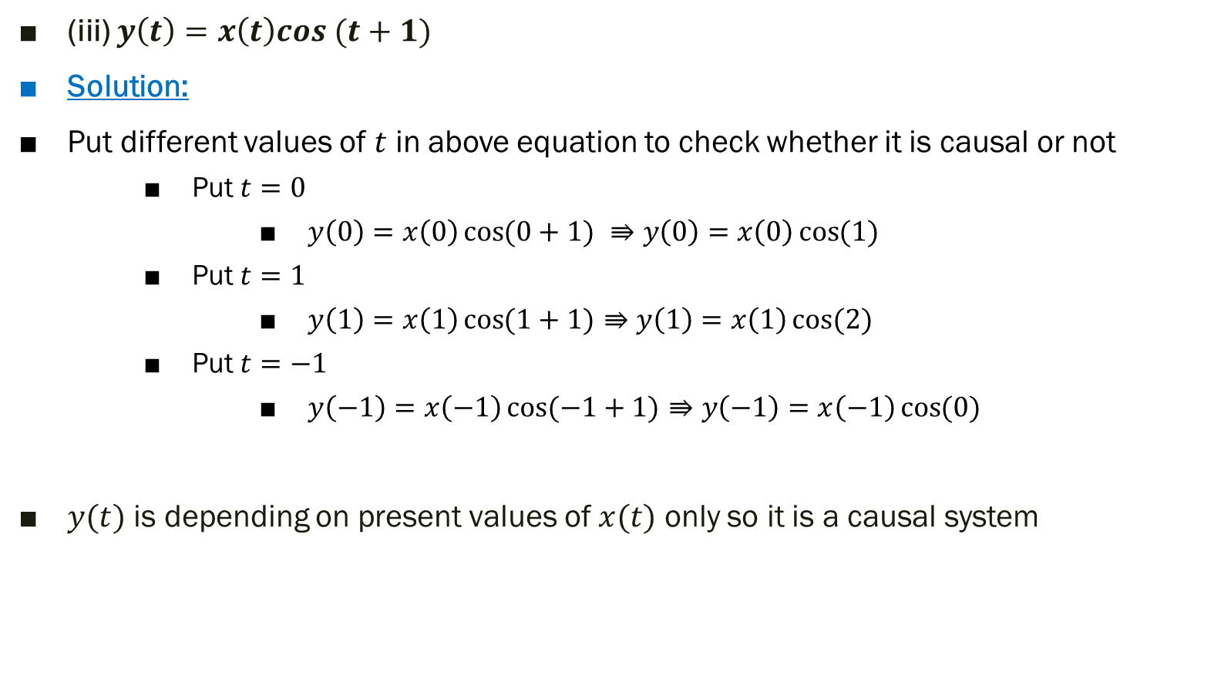
(iii) $y\left(t\right)=x\left(t\right)cos (t+1)$
Solution:
Put different values of $t$ in above equation to check whether it is causal or not
Put $t=0$
$y\left(0\right)=x\left(0\right)\cos{(0+1)} ⇛y\left(0\right)=x\left(0\right)\cos{(1)}$
Put $t=1$
$y\left(1\right)=x\left(1\right)\cos{(1+1)}⇛y\left(1\right)=x\left(1\right)\cos{(2)}$
Put $t=−1$
$y\left(−1\right)=x\left(−1\right)\cos{(−1+1)}⇛y\left(−1\right)=x\left(−1\right)\cos{(0)}$
$y(t)$ is depending on present values of $x(t)$ only so it is a causal system
present value of input
present value of input
present value of input

Slide 13
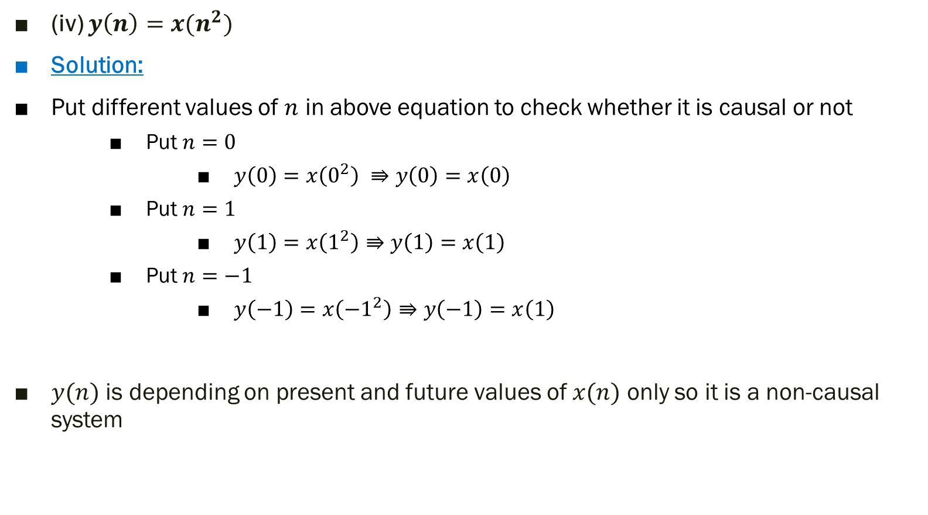
(iv) $y\left(n\right)=x(n^{2})$
Solution:
Put different values of $n$ in above equation to check whether it is causal or not
Put $n=0$
$y\left(0\right)=x\left(0^{2}\right) ⇛y\left(0\right)=x\left(0\right)$
Put $n=1$
$y\left(1\right)=x\left(1^{2}\right)⇛y\left(1\right)=x\left(1\right)$
Put $n=−1$
$y\left(−1\right)=x\left({−1}^{2}\right)⇛y\left(−1\right)=x\left(1\right)$
$y(n)$ is depending on present and future values of $x(n)$ only so it is a non-causal system

Slide 14
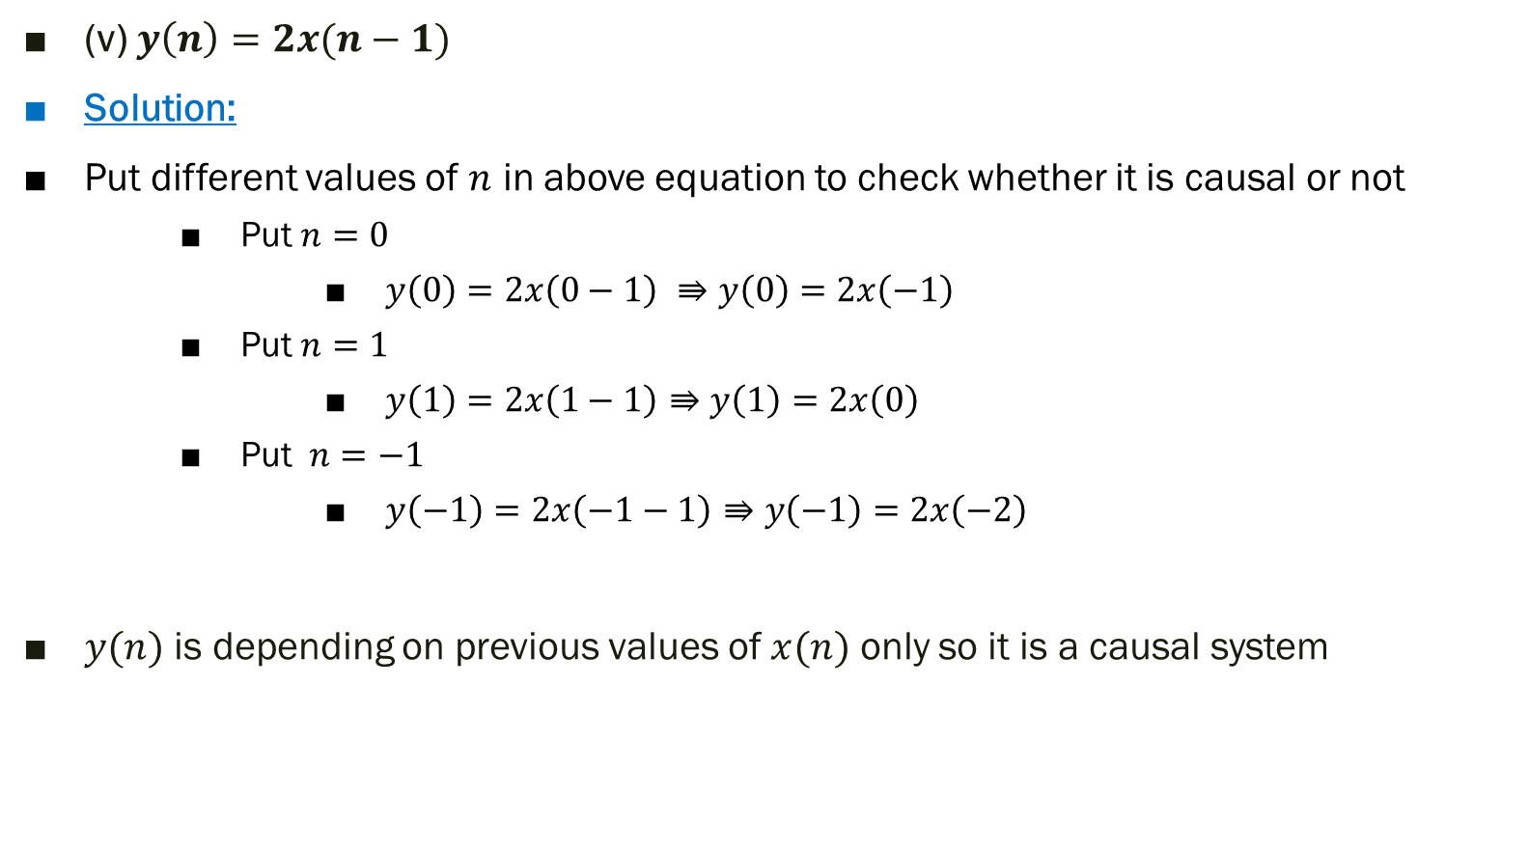
(v) $y\left(n\right)=2x(n−1)$
Solution:
Put different values of $n$ in above equation to check whether it is causal or not
Put $n=0$
$y\left(0\right)=2x\left(0−1\right) ⇛y\left(0\right)=2x\left(−1\right)$
Put $n=1$
$y\left(1\right)=2x\left(1−1\right)⇛y\left(1\right)=2x\left(0\right)$
Put $n=−1$
$y\left(−1\right)=2x\left(−1−1\right)⇛y\left(−1\right)=2x\left(−2\right)$
$y(n)$ is depending on previous values of $x(n)$ only so it is a causal system

Slide 15
2) Static (memoryless) and Dynamic (with memory) Systems
Static systems are also known as memoryless systems
Static systems contain no storage elements (thus, no integrals, derivatives or signal delays)
A static or memoryless system is a system with an output signal whose values depends upon the present value of the input signal only. Otherwise the system is dynamic or with memory.

Slide 16
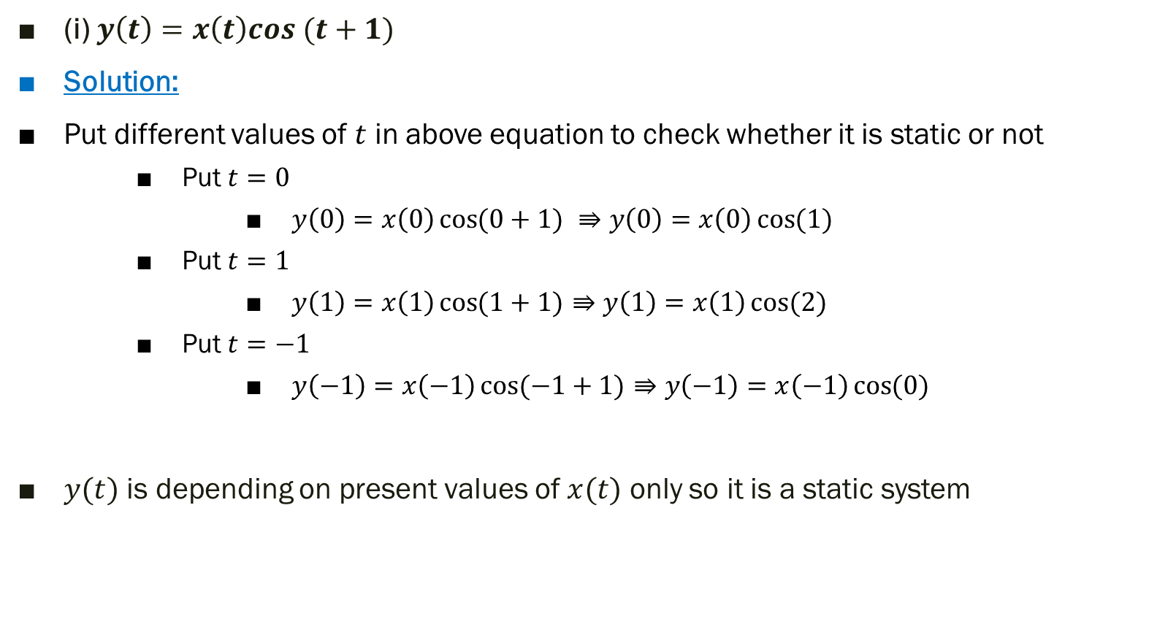
Exp 7.3: Determine whether the systems are static or dynamic
(i) $y\left(t\right)=x\left(t\right)cos (t+1)$
Solution:
Put different values of $t$ in above equation to check whether it is static or not
Put $t=0$
$y\left(0\right)=x\left(0\right)\cos{(0+1)} ⇛y\left(0\right)=x\left(0\right)\cos{(1)}$
Put $t=1$
$y\left(1\right)=x\left(1\right)\cos{(1+1)}⇛y\left(1\right)=x\left(1\right)\cos{(2)}$
Put $t=−1$
$y\left(−1\right)=x\left(−1\right)\cos{(−1+1)}⇛y\left(−1\right)=x\left(−1\right)\cos{(0)}$
$y(t)$ is depending on present values of $x(t)$ only so it is a static system

Slide 17

(ii) $y\left(t\right)=0.2x\left(t\right)−x(t−1)$
Solution:
Put different values of $t$ in above equation to check whether it is static or not
Put $t=0$
$y\left(0\right)=0.2x\left(0\right)−x\left(0−1\right) ⇛y\left(0\right)=0.2x\left(0\right)−x\left(−1\right)$
Put $t=1$
$y\left(1\right)=0.2x\left(1\right)−x\left(1−1\right) ⇛y\left(1\right)=0.2x\left(1\right)−x\left(0\right)$
Put $t=−1$
$y\left(−1\right)=0.2x\left(−1\right)−x\left(−1−1\right) ⇛y\left(−1\right)=0.2x\left(−1\right)−x\left(−2\right)$
$y(t)$ is depending on previous and present of $x(t)$ values only so it is a dynamic system

Slide 18
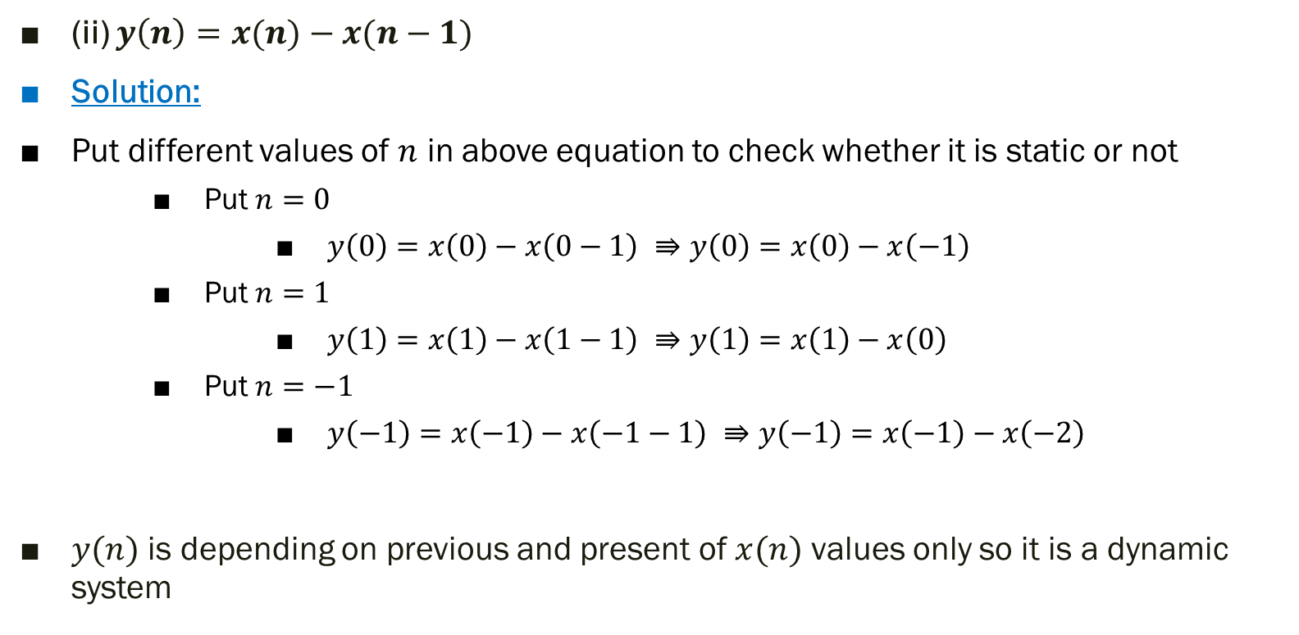
(ii) $y\left(n\right)=x(n)−x(n−1)$
Solution:
Put different values of $n$ in above equation to check whether it is static or not
Put $n=0$
$y\left(0\right)=x\left(0\right)−x\left(0−1\right) ⇛y\left(0\right)=x\left(0\right)−x\left(−1\right)$
Put $n=1$
$y\left(1\right)=x\left(1\right)−x\left(1−1\right) ⇛y\left(1\right)=x\left(1\right)−x\left(0\right)$
Put $n=−1$
$y\left(−1\right)=x\left(−1\right)−x\left(−1−1\right) ⇛y\left(−1\right)=x\left(−1\right)−x\left(−2\right)$
$y(n)$ is depending on previous and present of $x(n)$ values only so it is a dynamic system

Slide 19
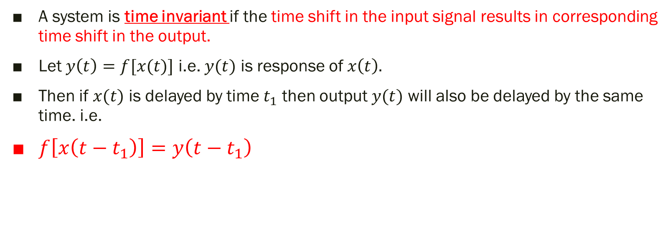
3) Time Invariant and Time Variant Systems
A system is time invariant if the time shift in the input signal results in corresponding time shift in the output.
Let $y\left(t\right)=f[x(t)]$ i.e. $y(t)$ is response of $x\left(t\right).$
Then if $x(t)$ is delayed by time $t_{1}$ then output $y(t)$ will also be delayed by the same time. i.e.
$f\left[x\left(t−t_{1}\right)\right]=y\left(t−t_{1}\right)$

Slide 20
Sr. # | Operation or system | Type
1 | Bus and train arrival and departure times | Time Invariant
2 | Rainfall per month | Time variant
3 | Thermal noise in components | Time variant
4 | Noise effects in radio communication | Time variant
5 | File handling in C language | Time invariant
6 | Printing documents by printer | Time invariant
Time invariant systems are independent of time/day/year whereas time variant systems are effected at which time you are analyzing the system.

Slide 21
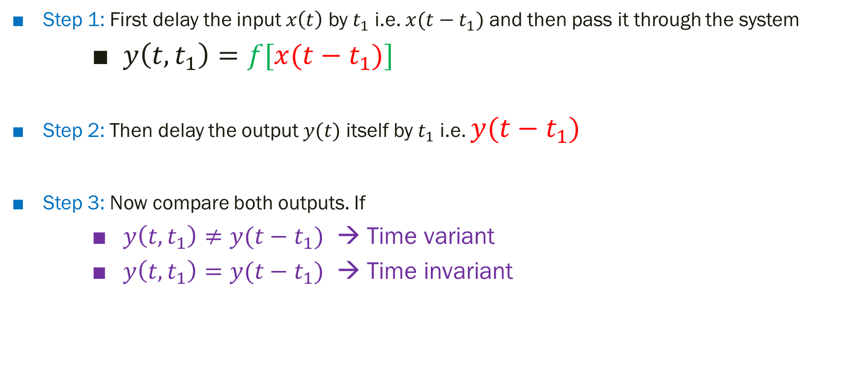
Steps to test for time invariance property
Step 1: First delay the input $x\left(t\right)$ by $t_{1}$ i.e. $x(t−t_{1})$ and then pass it through the system
$y\left(t,t_{1}\right)=f[x(t−t_{1})]$
Step 2: Then delay the output $y(t)$ itself by $t_{1}$ i.e. $y(t−t_{1})$
Step 3: Now compare both outputs. If
$y\left(t,t_{1}\right)≠y(t−t_{1})$ → Time variant
$y\left(t,t_{1}\right)=y(t−t_{1})$ → Time invariant

Slide 22






$$f\left[x\left(t−t_{1}\right)\right]=y\left(t,t_{1}\right)$$
$$x(t)$$
$$x(t−t_{1})$$
Shifting
System
R.H.S
$$x(t)$$
$$y(t)$$
$$y\left(t−t_{1}\right)$$
System
System
L.H.S

Slide 23
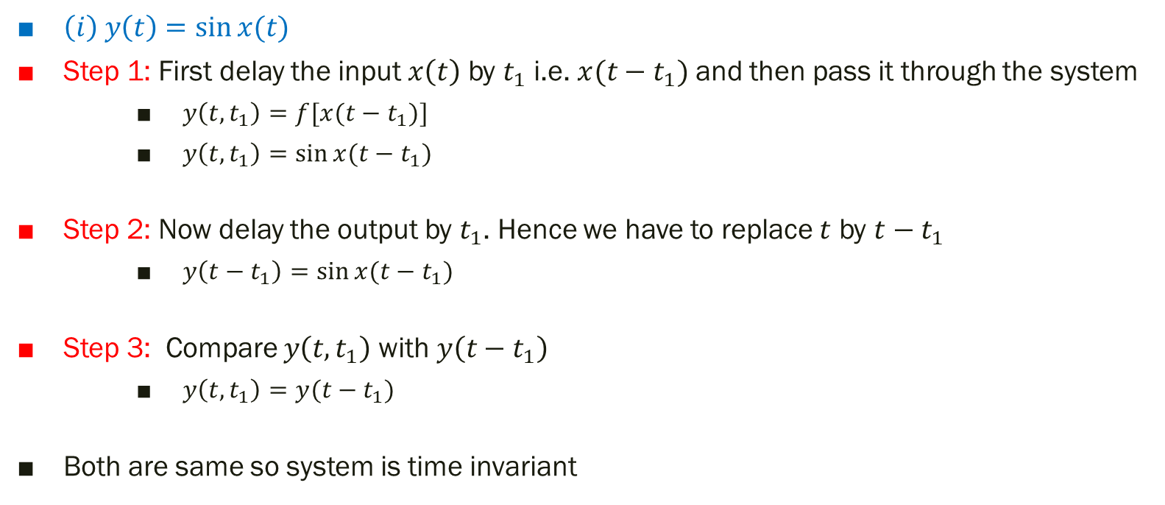
Exp 7.4: Determine whether the systems are time invariant or time variant
$\left(i\right) y\left(t\right)=\sin{x(t)}$
Step 1: First delay the input $x\left(t\right)$ by $t_{1}$ i.e. $x(t−t_{1})$ and then pass it through the system
$y\left(t,t_{1}\right)=f[x(t−t_{1})]$
$y\left(t,t_{1}\right)=\sin{x(t−t_{1})}$
Step 2: Now delay the output by $t_{1}$. Hence we have to replace $t$ by $t−t_{1}$
$y\left(t−t_{1}\right)=\sin{x(t−t_{1})}$
Step 3: Compare $y\left(t,t_{1}\right)$ with $y\left(t−t_{1}\right)$
$y\left(t,t_{1}\right)=y(t−t_{1})$
Both are same so system is time invariant

Slide 24
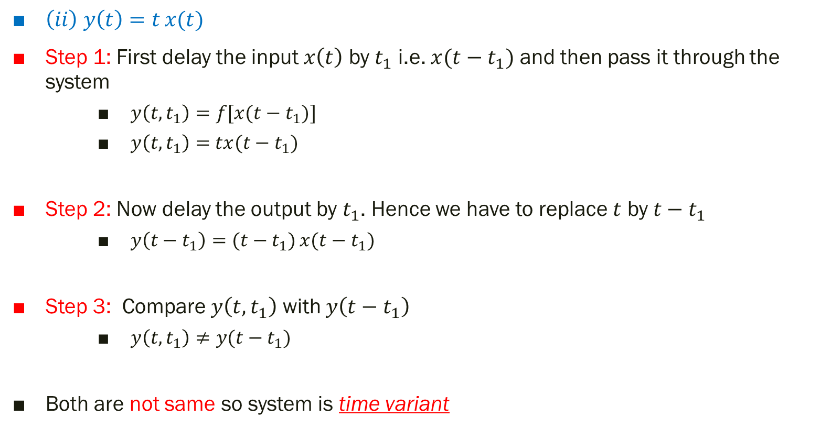
$\left(ii\right) y\left(t\right)=t{x(t)}$
Step 1: First delay the input $x\left(t\right)$ by $t_{1}$ i.e. $x(t−t_{1})$ and then pass it through the system
$y\left(t,t_{1}\right)=f[x(t−t_{1})]$
$y\left(t,t_{1}\right)=$ $tx(t−t_{1})$
Step 2: Now delay the output by $t_{1}$. Hence we have to replace $t$ by $t−t_{1}$
$y\left(t−t_{1}\right)=(t−t_{1}){x(t−t_{1})}$
Step 3: Compare $y\left(t,t_{1}\right)$ with $y\left(t−t_{1}\right)$
$y\left(t,t_{1}\right)≠y(t−t_{1})$
Both are not same so system is time variant

Slide 25
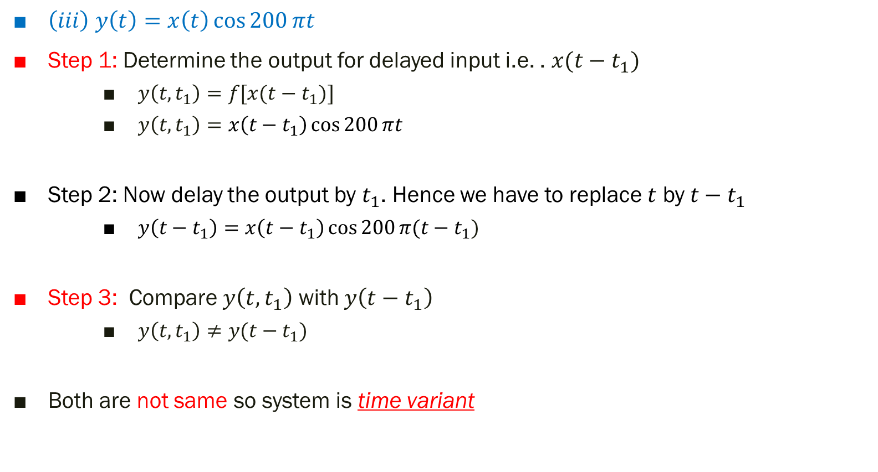
$\left(iii\right) y\left(t\right)=x\left(t\right)\cos{200}πt$
Step 1: Determine the output for delayed input i.e. . $x(t−t_{1})$
$y\left(t,t_{1}\right)=f[x(t−t_{1})]$
$y\left(t,t_{1}\right)=x\left(t−t_{1}\right)\cos{200}πt$
Step 2: Now delay the output by $t_{1}$. Hence we have to replace $t$ by $t−t_{1}$
$y\left(t−t_{1}\right)=x\left(t−t_{1}\right)\cos{200}π(t−t_{1})$
Step 3: Compare $y\left(t,t_{1}\right)$ with $y\left(t−t_{1}\right)$
$y\left(t,t_{1}\right)≠y(t−t_{1})$
Both are not same so system is time variant

Slide 26
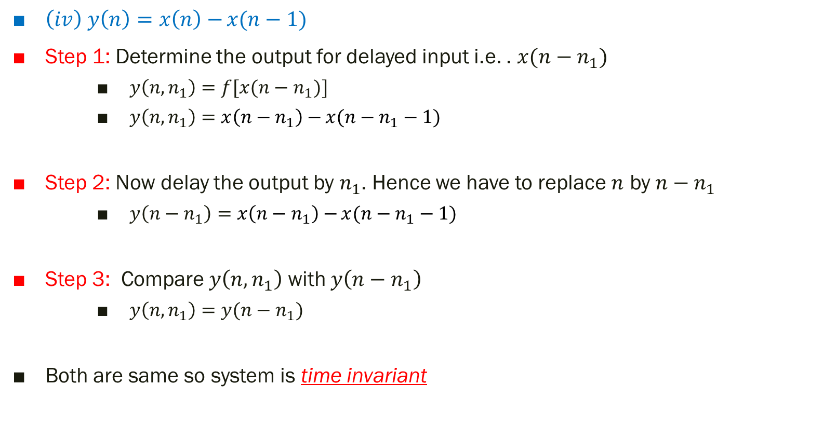
$\left(iv\right) y\left(n\right)=x\left(n\right)−{x(n−1)}$
Step 1: Determine the output for delayed input i.e. . $x(n−n_{1})$
$y\left(n,n_{1}\right)=f[x(n−n_{1})]$
$y\left(n,n_{1}\right)=x\left(n−n_{1}\right)−{x(n−n_{1}−1)}$
Step 2: Now delay the output by $n_{1}$. Hence we have to replace $n$ by $n−n_{1}$
$y\left(n−n_{1}\right)=x\left(n−n_{1}\right)−{x(n−n_{1}−1)}$
Step 3: Compare $y\left(n,n_{1}\right)$ with $y\left(n−n_{1}\right)$
$y\left(n,n_{1}\right)=y(n−n_{1})$
Both are same so system is time invariant

Slide 27
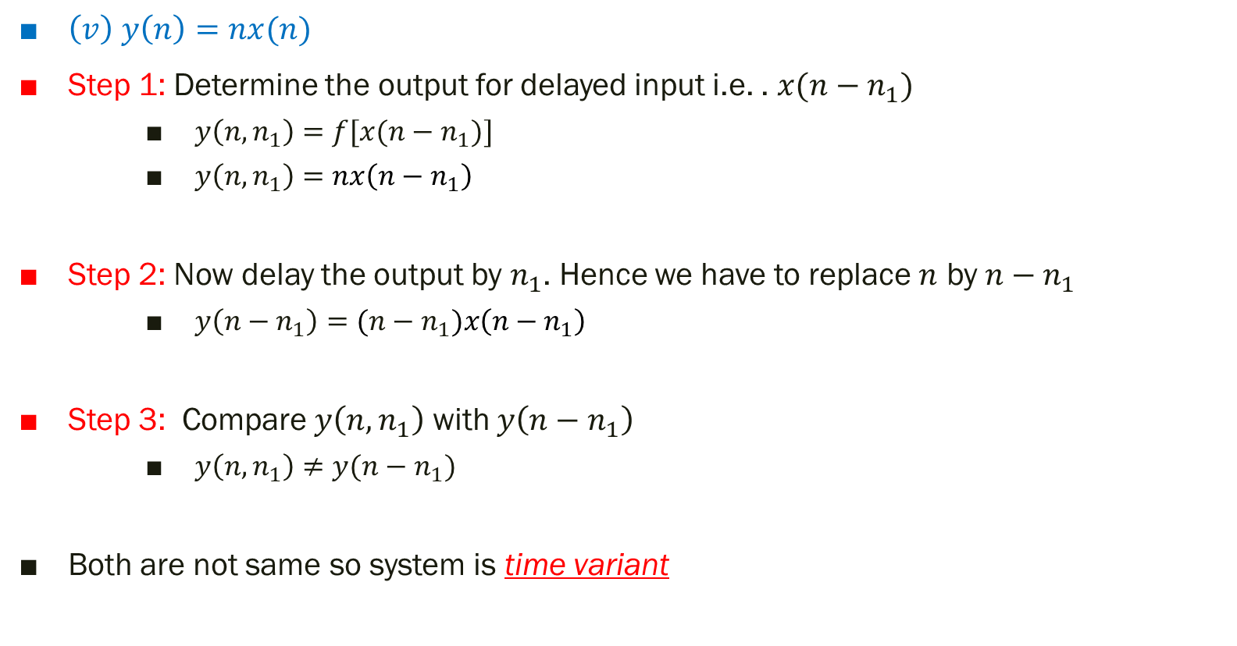
$\left(v\right) y\left(n\right)=nx(n)$
Step 1: Determine the output for delayed input i.e. . $x(n−n_{1})$
$y\left(n,n_{1}\right)=f[x(n−n_{1})]$
$y\left(n,n_{1}\right)=nx\left(n−n_{1}\right)$
Step 2: Now delay the output by $n_{1}$. Hence we have to replace $n$ by $n−n_{1}$
$y\left(n−n_{1}\right)=(n−n_{1})x\left(n−n_{1}\right)$
Step 3: Compare $y\left(n,n_{1}\right)$ with $y\left(n−n_{1}\right)$
$y\left(n,n_{1}\right)≠y(n−n_{1})$
Both are not same so system is time variant

Slide 28
Thank You !!!

